Slide 1
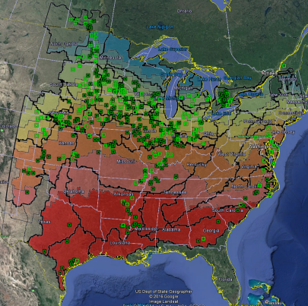
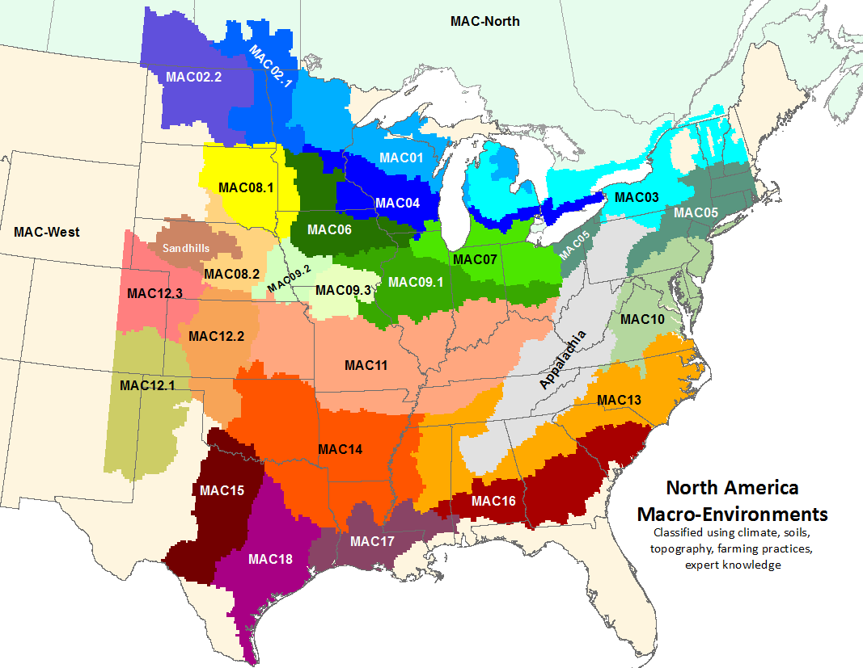
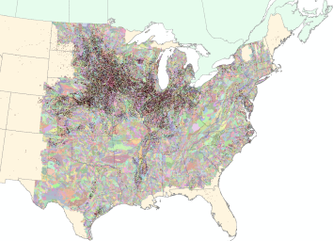
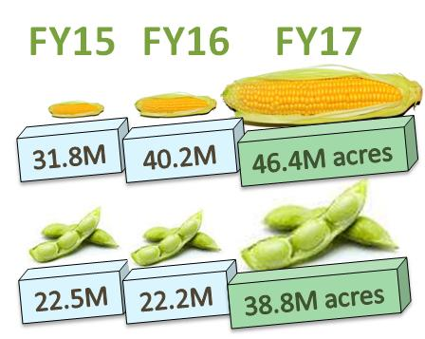
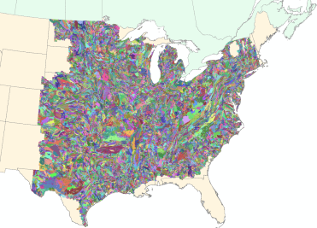
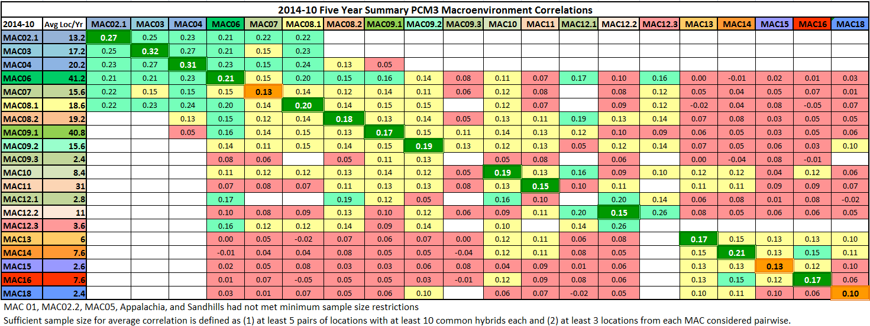
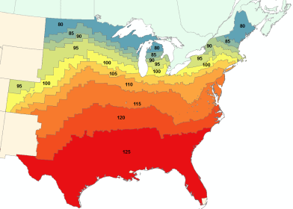
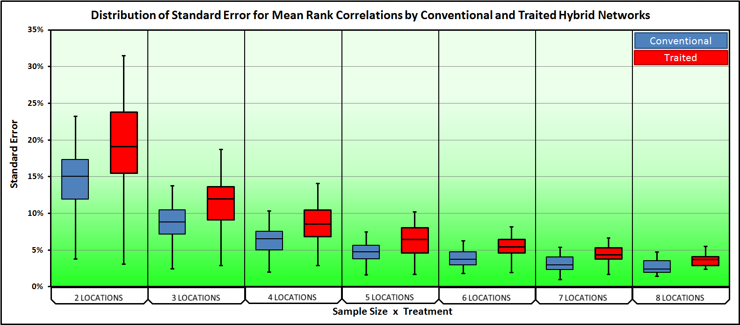
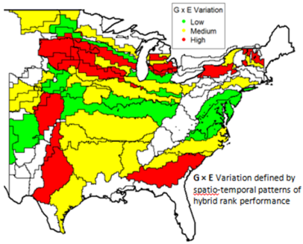
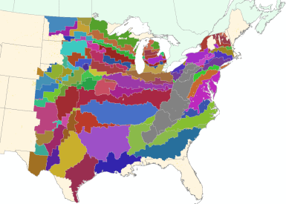
Science-driven Testing Network Optimization
MAC
MAC x RM x Soil x Acres
MAC x RM x Soil
MAC Evaluation (GxE)
RM
Power Analysis
MAC x RM GxE Variability
MAC x RM
(#locs/MACxRM)
Notes:
Understand environments
Evaluate Environment clusters from Breeding perspective
Know your pipeline
Environments and pipelines interact
Quantify GxE
How many locations do you need?
Where do you place them?
Prioritize environemnts to represent our customers.

Slide 2
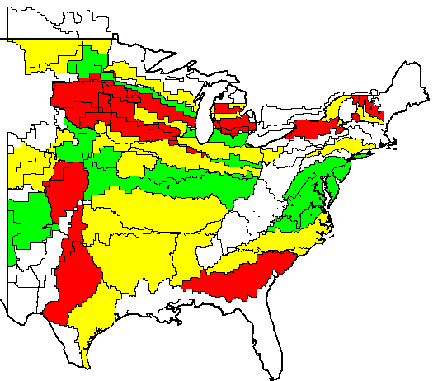
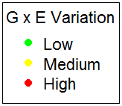
Meet the Minimum Required Sample Size for Capturing GxE levels
3
Proportional
Fully Comprehensive Network
Reflect Population Proportions
Extreme Precision Sampling
Too Costly
2
Represent Factors
Contrast Select Variables
Target Large
MAC × ZoneRMs
Test for Fixed Effects
Ex: Irrigation, Soil Types
1
MAC * RM
Capture G × E
Understand Our Products
G × E Precision defined by spatio-temporal patterns of hybrid rank performance
UNTRAITED: 242
TRAITED: 295
Product Variability
& Diverse Locations
A
A
Step 1
Quantified G × E Precision for all MAC*RM
r = 20%
r = 10%
r = 20%
r = -10%
Step 2
Calibrated Location Sampling by Corn Acreage
Step 3
Built to Detect Hybrid Performance Patterns
B
C
B
C
Constructed Traited and Untraited Network
r = 30%
r = 50%
Step 4
Low G × E Variation
Weak disagreement
High G × E Variation
Strong disagreement
Step 5
Attrition and Extended MAC*RM Datacuts
GOAL!
Sample the Most Diverse Corn Markets Understand Product Variability
Notes:
Sampling hybrids for performance follows a three step hierarchy:
Capturing G*E: Identify consistencies in our products performance
Representing Factors: Learn how specific factors affect our products performance
Proportional to Population: Summary statistics estimate population parameters
Our target for our testing network should be for Capturing G*E.
We need to understand the variability of our product.
The Macroenvironments and RM Zones are a great tool for removing heterogeneity among environmental factors.
We can anticipate the G*E interactive effect would have less heterogeneity within a Mac*ZoneRM geographic stratification.
The number of locations we select in each sampling unit should be determined by removing uncertainty in the G*E interaction.
We cannot have representation without capturing G*E.
Measuring effects of factors is a secondary purpose.
We cannot have proportionality without representation.
The number of samples we need to capture G*E in US is 242 locations.
I have built the framework for the number of locations we need.

Slide 3
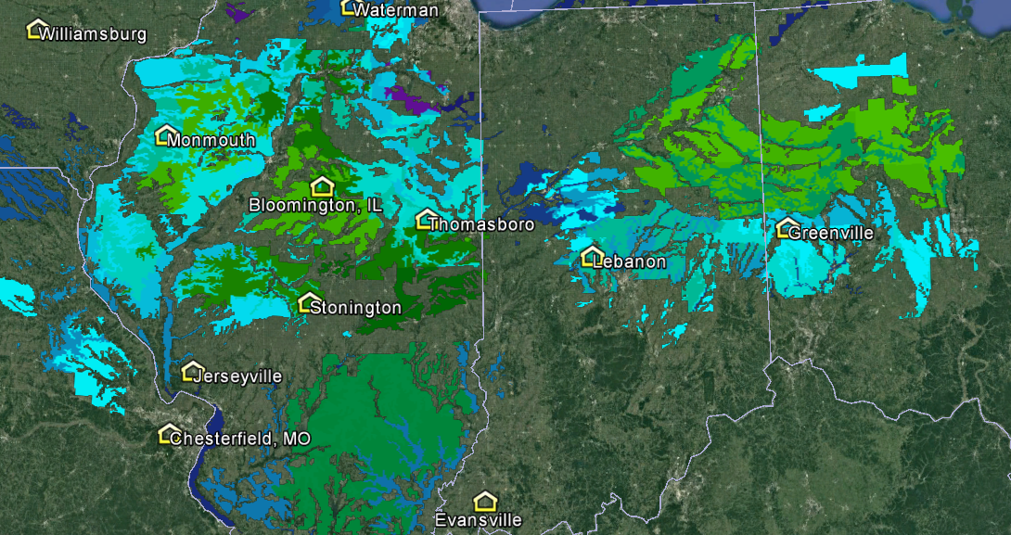
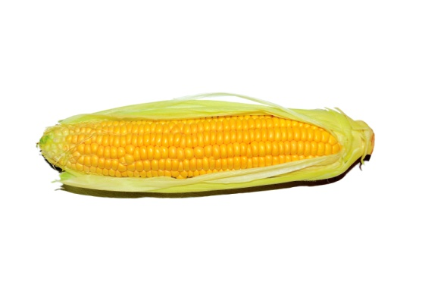


FY17 Parallel Crop Environments (January 23, 2016)
High Acres
Corn (407)
Sorghum
302
Soy (224)
105
119
Cotton
Winter Wheat
Low Acres
631 Sites, 526 Locations, 1 Network
Spring Wheat
E
X
P
A
N
S
I
O
N
FY15
FY16
FY17
R
E
P
O
N
S
I
B
L
E
O
G
R
E
S
S
I
O
N
P
R
C
E
I
F
E
B
A
L
A
N
W
O
R
K
-
L
31.8M
40.2M
46.4M acres
S
A
F
E
T
Y
O
N
F
I
D
E
N
C
E
C
N
A
L
Y
T
I
C
S
D
R
I
V
E
N
A
D
A
T
A
E
S
E
N
T
A
T
I
O
N
R
E
P
R
22.5M
22.2M
32.6M acres
A
N
A
G
E
M
E
N
T
M

Slide 4
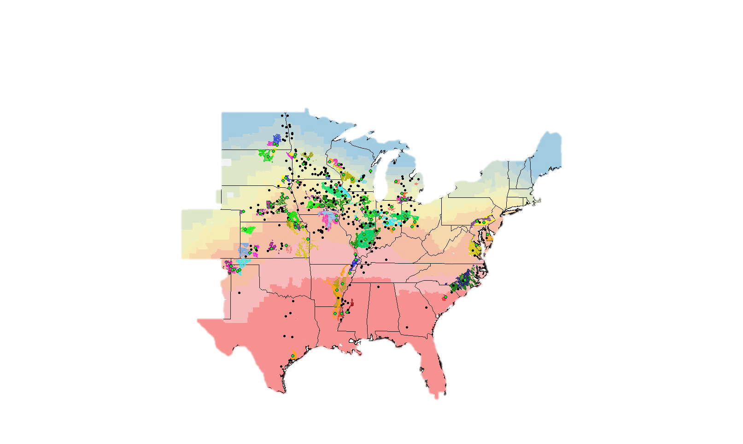
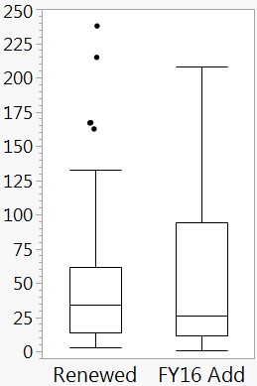
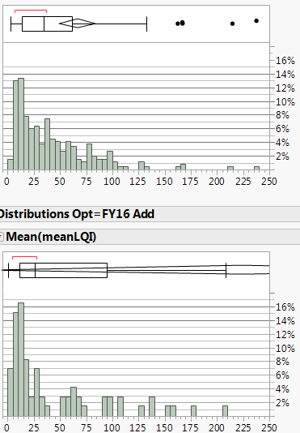
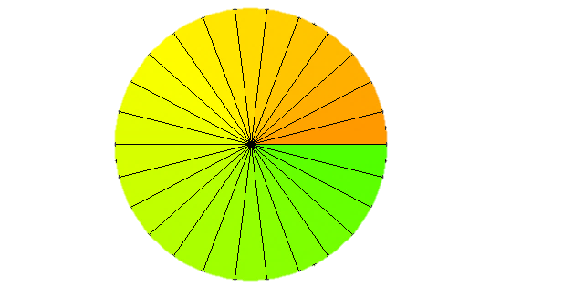
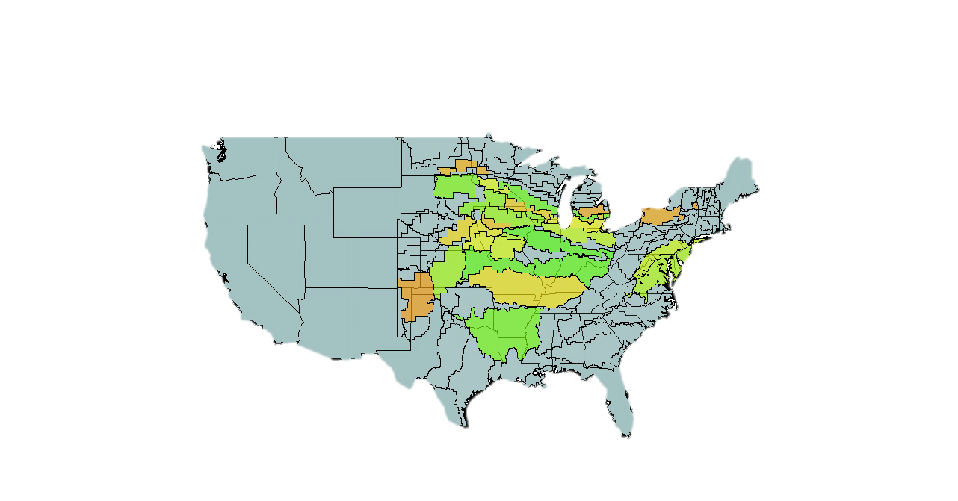
Three Pillars Support Optimization
FY16 Add
FY16 Renew
+97 Locations
+8.3M Acres
+P4/P3 Placement
OPTIMIZATION
Representation
COMPARABLE Location Quality Index
Renewed
LQI | Locs | Mean | Median
Renewal | 272 | 38 | 34
FY16 Add | 74 | 47 | 26
Lower LQI Implies Better Quality
QUALITY DATA
Quality Data
REPRESENTATION
NEW KNOWLEDGE
FY16 Add
Slightly Similar
Similar Performance
Repetitive Performance
New Knowledge
Neutral Performance
Contrasting Performance
Neutral Performance
Different
Performance

Slide 5
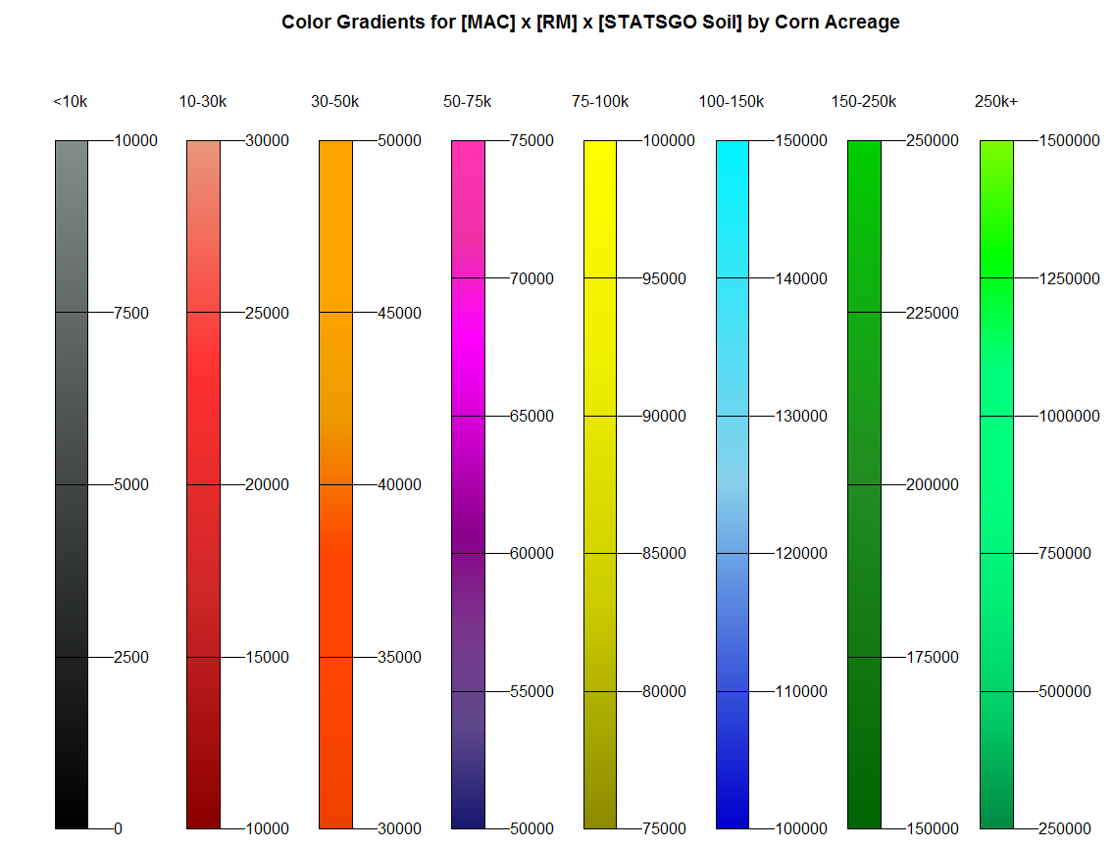
1) Corn Market Representation
FY16 Optimization
OPTIMIZATION
Added 97 Locations
○ +4 Locs per Hub
○ Undersampled Environments
○ +P4/P3 Placement
QUALITY DATA
REPRESENTATION
NEW KNOWLEDGE

Slide 6
2) Comparable Quality in Datasets
Added and Renewed Locations have comparable Location Quality Indices (LQI)
OPTIMIZATION
Renewed
QUALITY DATA
REPRESENTATION
NEW KNOWLEDGE
FY16 Add

Slide 7
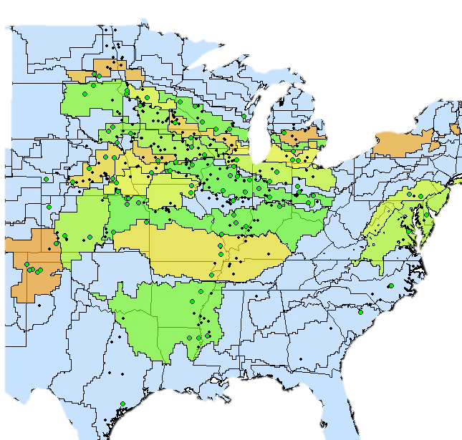
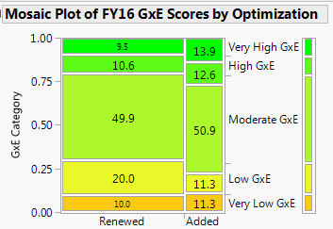
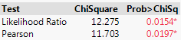
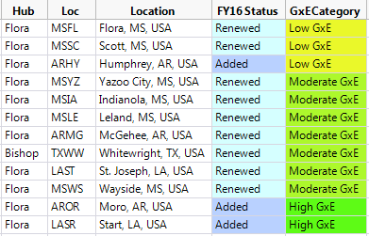
3) New Knowledge from Contrasting Yields
FY16 Add
FY16 Renew
OPTIMIZATION
QUALITY DATA
REPRESENTATION
NEW KNOWLEDGE
PCM4 Example:
MAC 14 ◊ RM125 ◊ GENSS 120
Slightly Similar
Similar Performance
Repetitive Performance
Neutral Performance
Contrasting Performance
Neutral Performance
Different
Performance

Slide 8
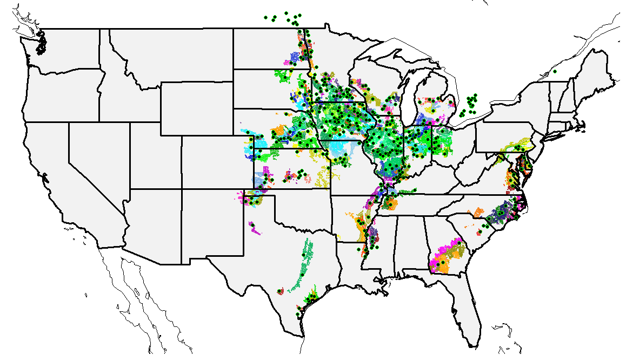
FY17 Corn Breeding Testing Network
FY15
FY16
FY17
31.8M
40.2M
46.4M acres

Slide 9
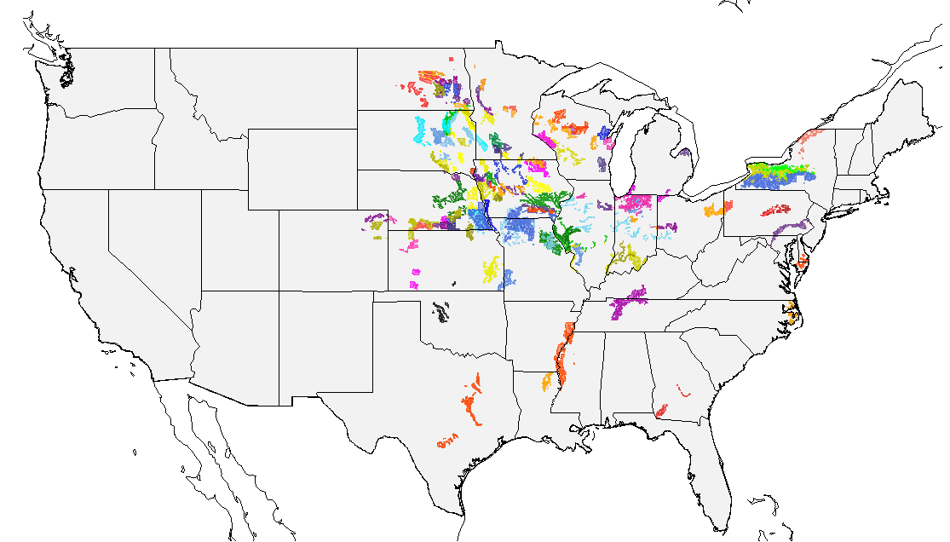
FY17 Corn Undersampled Environments

Slide 10
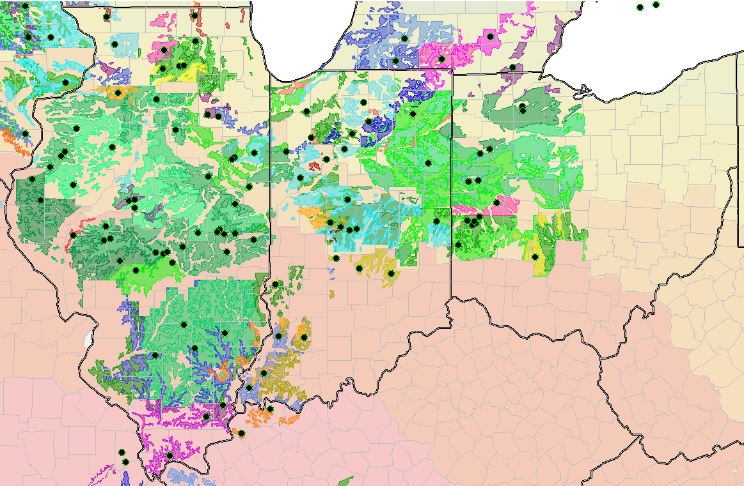
Illinois / Indiana / Ohio

Slide 11
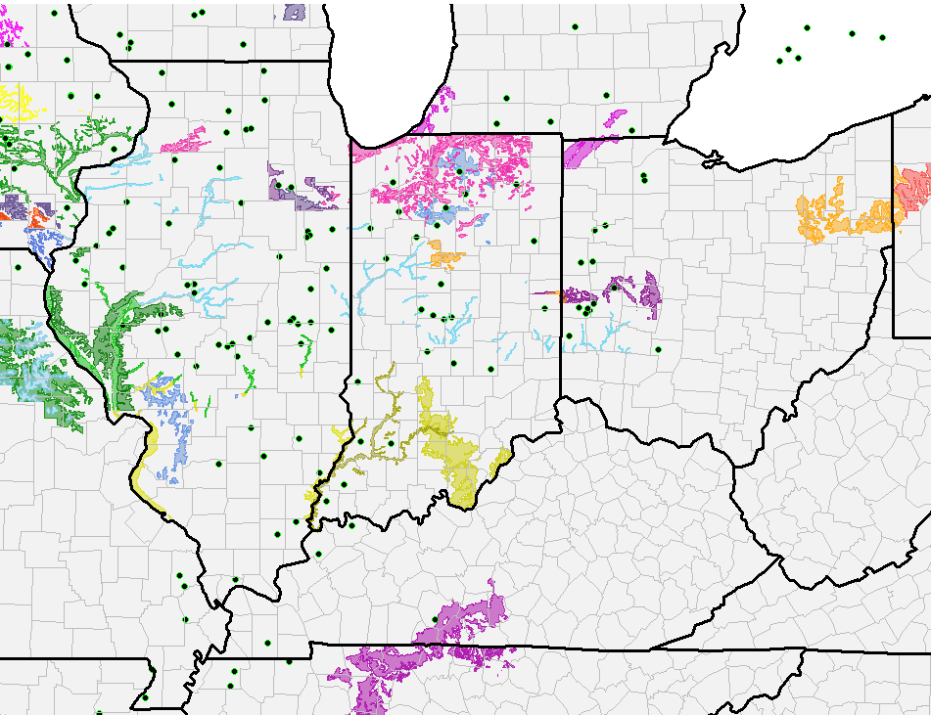
Illinois / Indiana / Ohio

Slide 12
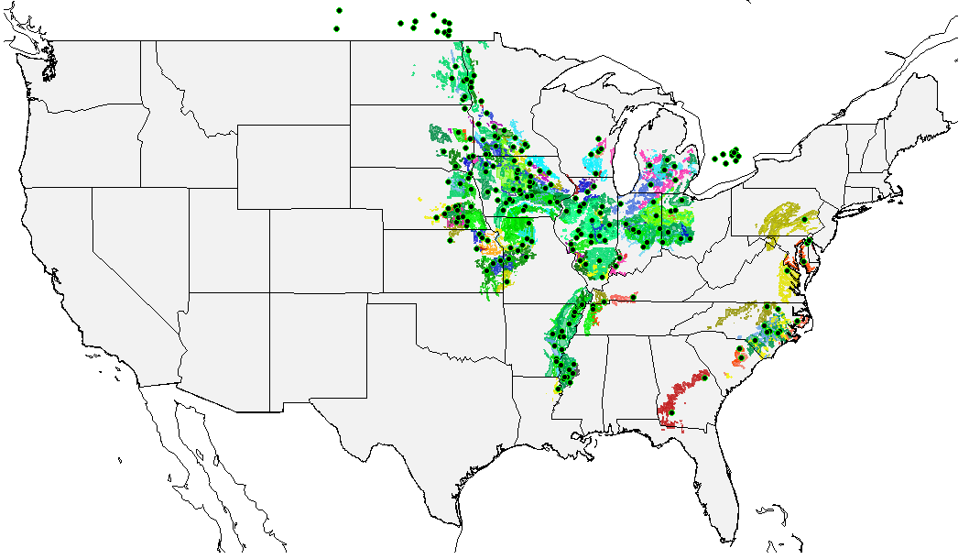
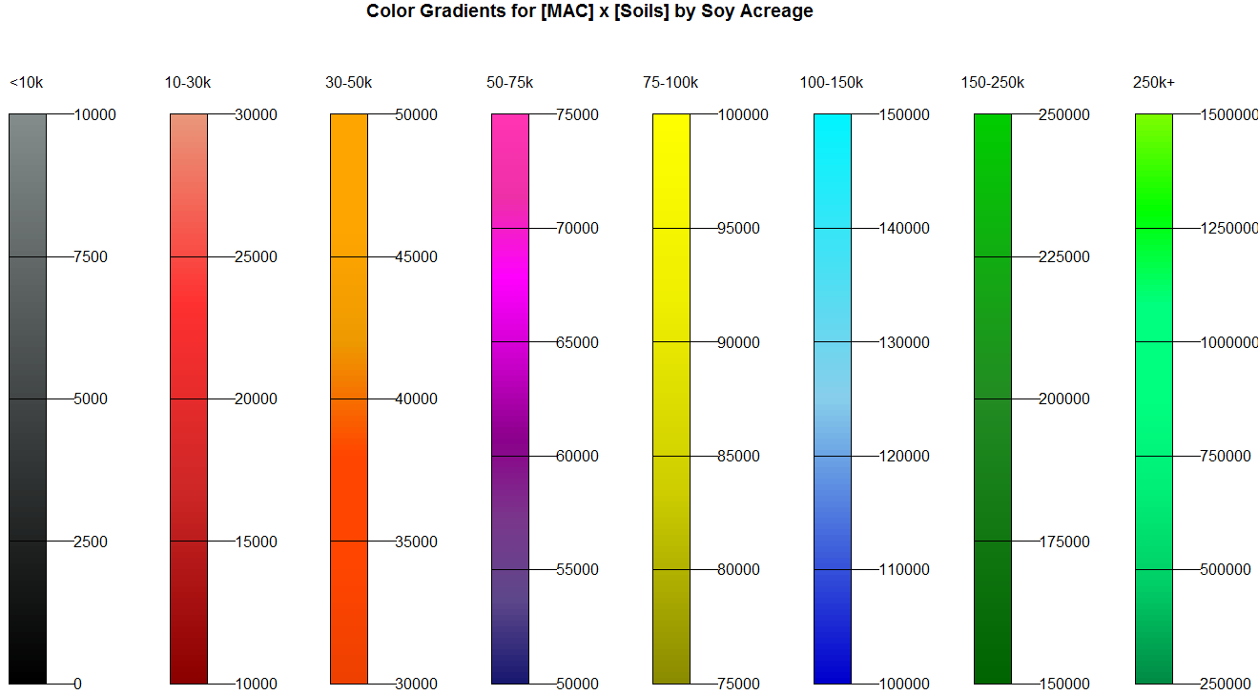
FY17 samples +47% more soy acres (32.7M)
FY15
FY16
FY17
22.5M
22.2M
32.6M acres

Slide 13
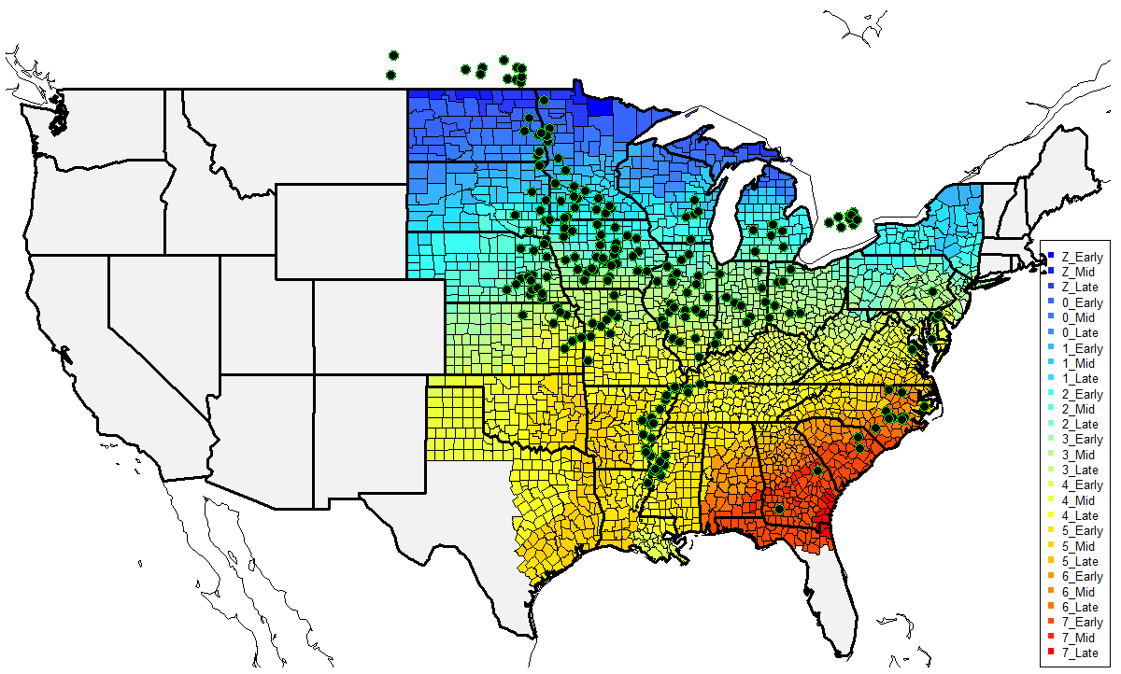
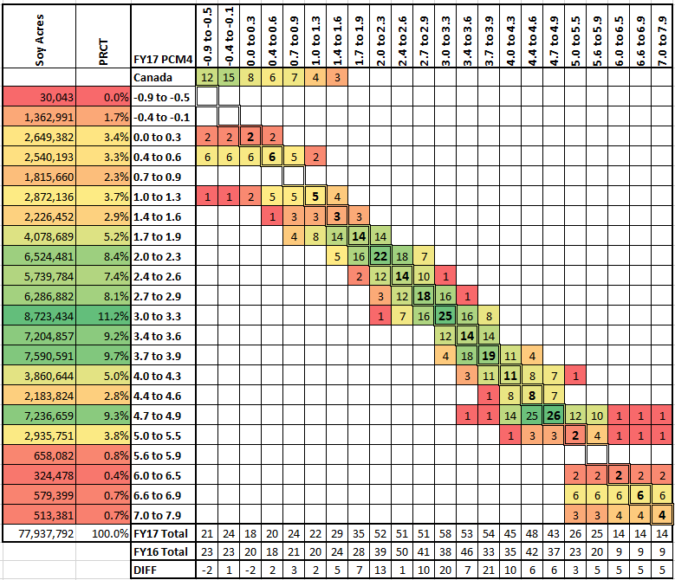
FY17 Testing Aligns with Soy Maturity

Slide 14
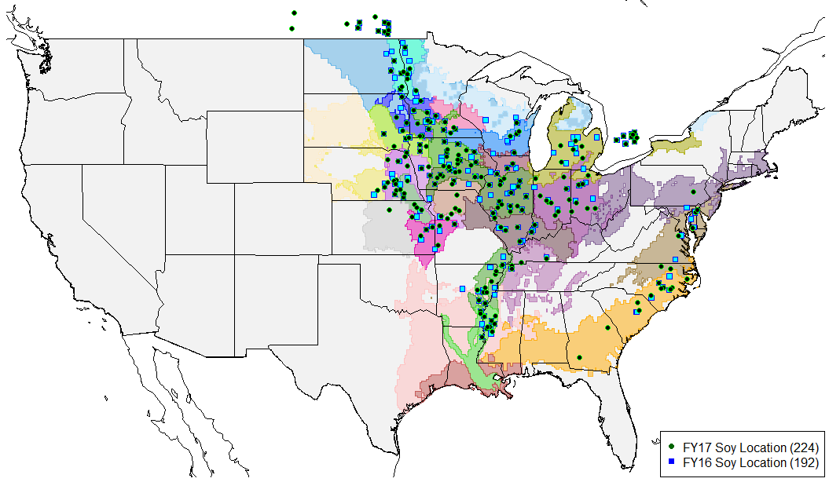
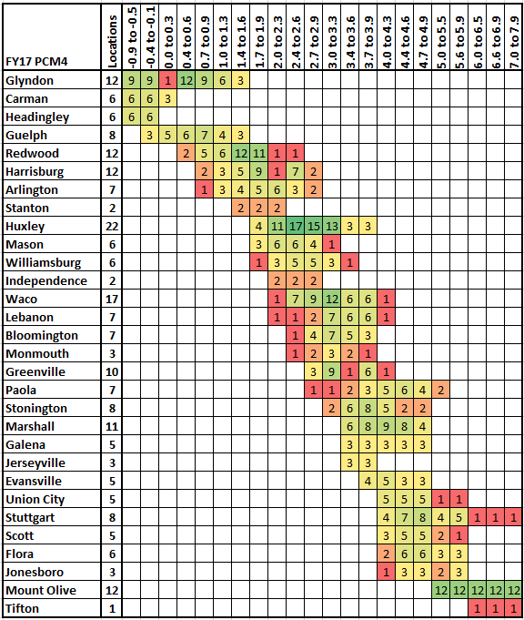
FY17 Soy Testing Locations Increased +32

Slide 15
Testing Network Optimization Roadmap
We’re going global!!
DRAFT

Slide 16
FY17 Soy Testing Locations Increased +32

Slide 17



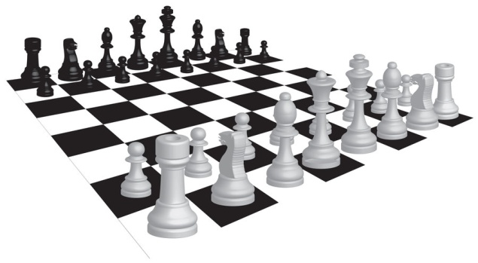
Autoset Placement
COLLOCATION
ATTRITION
Calibrated Phenotyping Network across colliding influential factors
FY17: 1.3 Million Plots Placed with Algorithms
Autoset Placement Model nominates sets for locations
Breeders made tactical business moves
CROP MARKET
Autoset Placement
MANAGEMENT
ENVIRONMENTS
G x E
FIXED EFFECTS
LOCATION
UNIQUENESS

Slide 18

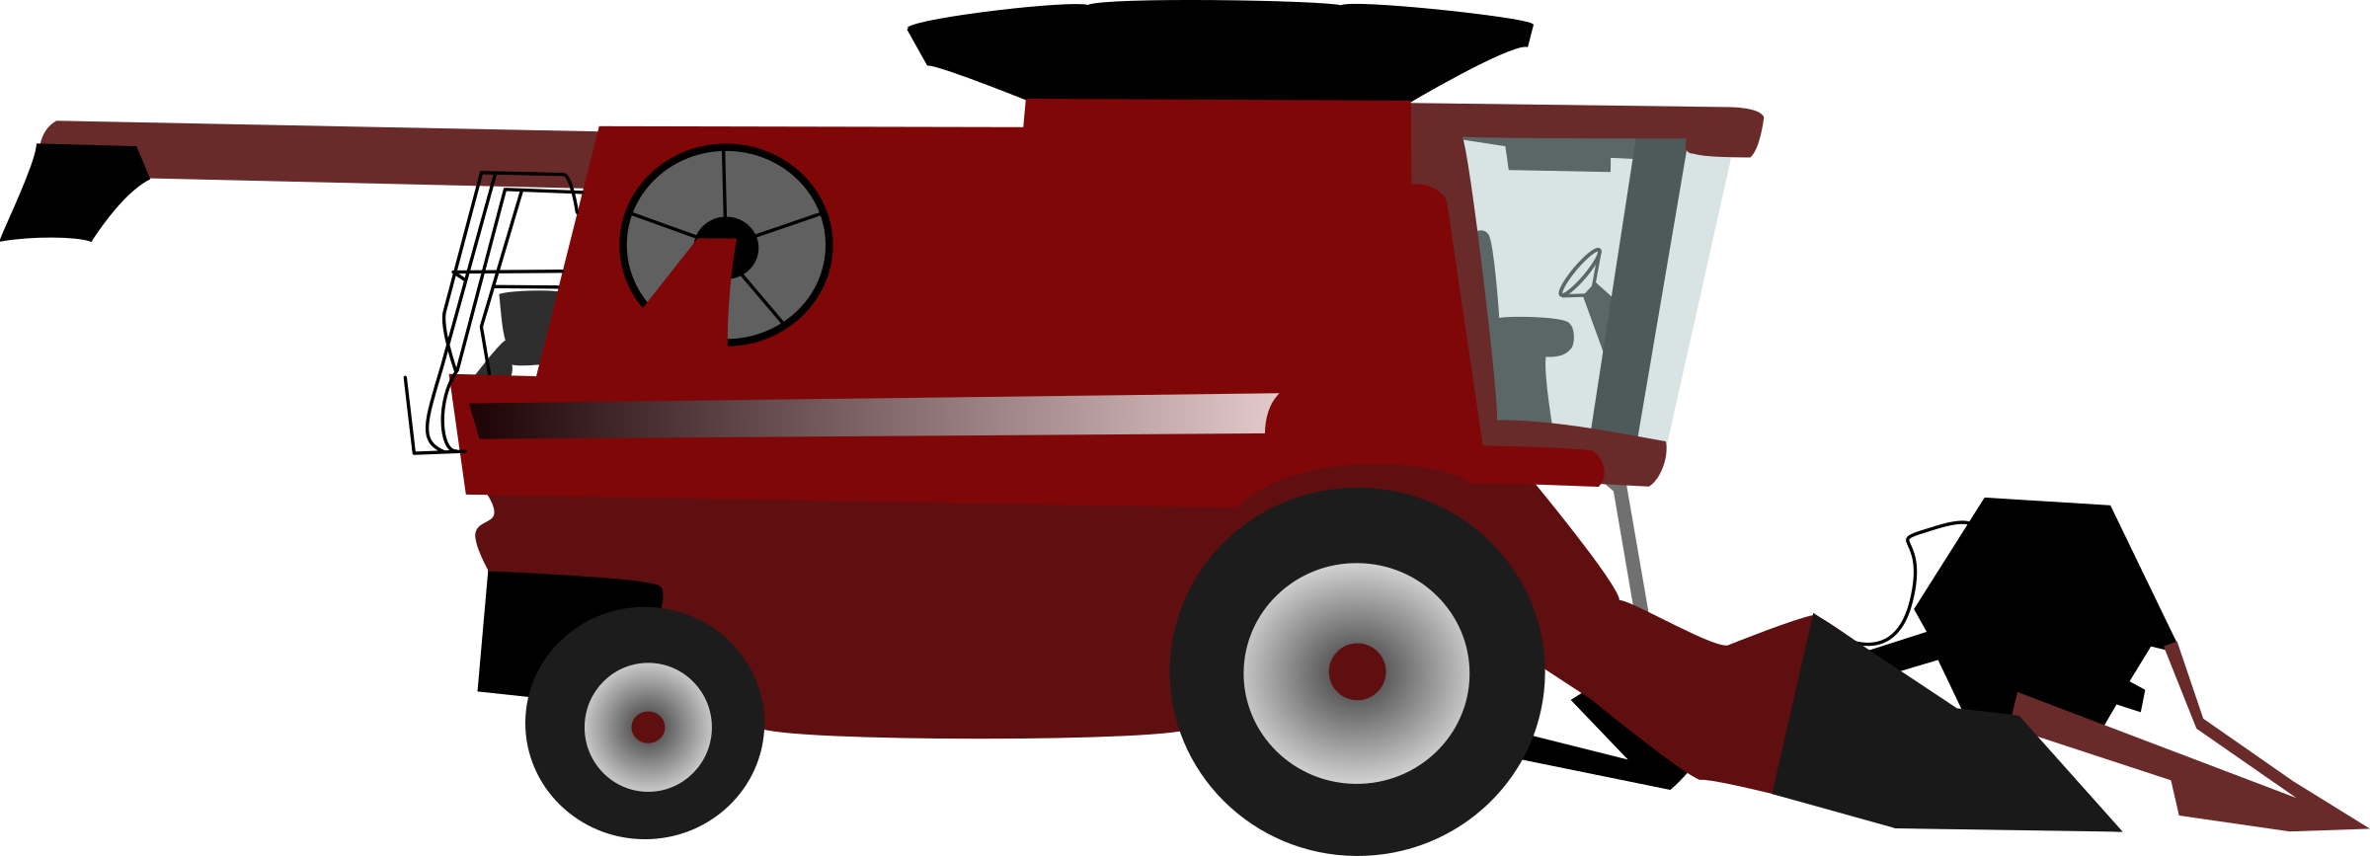

Testing Operations: Matt Brenneman, Jeff Peterson, Jenn Winson, Ryan Tichich, Mark Wood, Graham McGregor, Nick Kessler, Rex DeBruin, Trish Rexing, Kendal Bonds, Darin McDaniel, John Hickey, Ben Christen, Andy Frey, John Hardin, Brett Wilson, Ben Stonewall, Brad Serven, Kevin Barrett, Aaron Kramer, Mark Sellman, Keith Jackson, TJ Brown, Terry Beeler, Molly Drimmel, Jerry Garcia, Chad Becker, Chris Warner, Matt Bershon, John Van Staalduinen, Matt Garber, Brandon Miller, Dave Powell, Scott Gunning, Dan Clevenger, Eric Hickenbottom, Jason Carr, Dean Remington, Doug Bergman, Sammy Soignier, Griff Griffith, Luke Carpenter, Todd Isbell, Doug Bergman
Crop Breeding: Chris Souder, Christian Buffard, Duane Potrzeba, Jeff Sernett, Dick Stelpflug, Gary Stangland, Greg Holland, Sandeep Bhatnagar, Rafael Mateo, Laron Peters, Peter Guzman, Scott Bergemen, Sara Pappathopoulos, Magen Eller, Khusi Tiwari, Dan Lubich, Fufa Birru, Jared Webb, Atila Deak, Jack Phillips, Peter Lynch, Christian Buffard, Tom Jury, David Hoffman
Pipeline Logistics: Jason Alsup, Jeff McElroy, Megan Chittick
Special Thanks: Ross Bricklemyer, Bobby Brauer, Shaun Diltz, Kush Bhusal, Katy Hillard
Breeding Leadership: Mike Graham, Gerry Dill, Slobodan Trifunovic, JD Rossouw, Trevor Hohls, Warren Kruger
Technology Development: Mark Lawson, David Maas, Chris Schuster, Alan Strake, Corby Jensen, Jeff Eurek, Douglas Doty, Roger Olson, Chris Mayo, Safeer Hassan, Robert Brown, Travis Courtney, Kari Neis, Matthew Wommack, Justin Pollard, Petra Rosario, Amanda Schoch, Andrew Knepp, Bob Buehler, Eric Blinka, Daljit Singh, Brad Schottel, Walter Mayhew, Julius Brooks, Terry Semmel, Kyle Broughton, Kyle Johnson, Jared Hauseman
ACKNOWLEDGEMENTS

